Slide 1
What do you know about interviews?
Presented by: Mrs. Edwards
Career Development Coordinator
sedwards4@wcpss.net

Slide 2
Your Future…
It is time to start preparing for your future career!
Today, I want to discuss job interview skills.
Let’s see how much you already know!

Slide 3
Research the Company
Know the company’s mission and products
Know why you want to work for them
Know why they should hire you
Show you are truly interested and enthusiastic

Slide 4
How long does it take for the interviewer to make a first impression?
20-30 seconds!
That’s all you have to make a first impression!

Slide 5
DRESS CONSERVATIVELY
Important to make the interviewer focus on your intelligent answers, not your flashy attire!

Slide 6
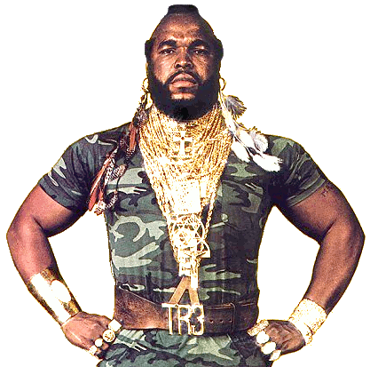
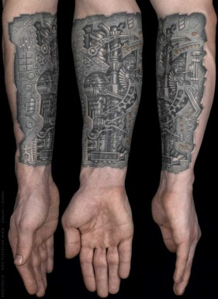
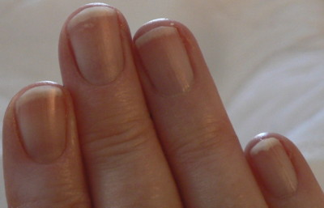
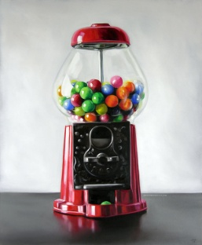

Slide 7
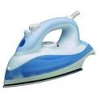
Be Ready the Day Before & Arrive 20 Minutes Early

Slide 8
Handshake and Eye Contact

Slide 9
Why Smile?
What does your smile say about you?
What does it say to the potential employer?
What characteristic does it show that an employer is seeking in an employee?

Slide 10
Have a Positive Attitude! Believe in Yourself!

Slide 11
PREPARE
Interviews make people nervous!
Feeling prepared increases your confidence!
Being confident, not cocky will help you to have a more positive attitude and appear more competent!

Slide 12
HAVE A “PLAN B”
You want to brainstorm as many examples of your skills and experience as possible so that questions will not stump you!

Slide 13
Skills to Emphasize
Teamwork
Communication
Computer
Organization
Motivation
Work Ethic
Honesty
Flexibility
Goal-oriented

Slide 14
Know your strengths!

Slide 15
Know your weaknesses!

Slide 16
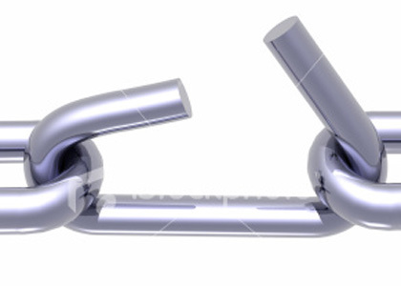
How to answer weakness question
Offer a weakness not related to position
Offer a weakness that you have overcome
Offer a weakness that is really a strength (this is difficult!)

Slide 17
Ex: Weakness that is a Strength
For example, you can say, “I try to take on too much work” or “I try to balance multiple projects” and have missed some deadlines because of it.
How does this make you appear to the interviewer?
It will hopefully make you appear to be a hard worker.
The manager can easily help you to manage your time and the workflow.
However, it is difficult for them to provide you with intrinsic motivation if you don’t already have it.

Slide 18
Don’t criticize others!

Slide 19
Difficult question…
It is okay to pause and get your thoughts together!

Slide 20
Practice and build confidence!

Slide 21
Practice Tips

Slide 22
Brainstorm Questions to Ask
WHY?

Slide 23
Sample Questions
Can you describe what a day is like working for your company?
What are the opportunities for advancement in your company?
Do you have a time-line for when you will fill the position?

Slide 24
After the interview…
WHY?

Slide 25
Thank the Interviewer
Thank you cards are a great idea!

